Slide 1
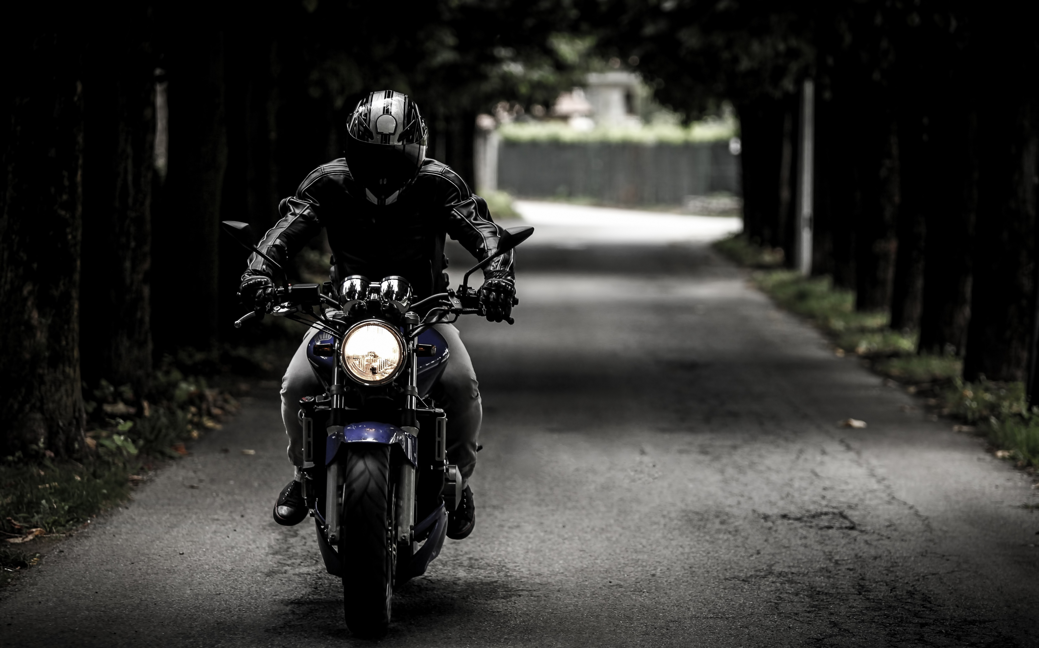
MOTOROID
HOME
RIDER
RENTER
A Better Way To Choose
Your Ride

Slide 2

MOTOROID
HOME
RIDER
RENTER
Motorcycle
Car

Slide 3

MOTOROID
HOME
RIDER
RENTER
Motorcycle
Bajaj Pulsar 150
Yamaha fzs 150
RENT
RENT

Slide 4
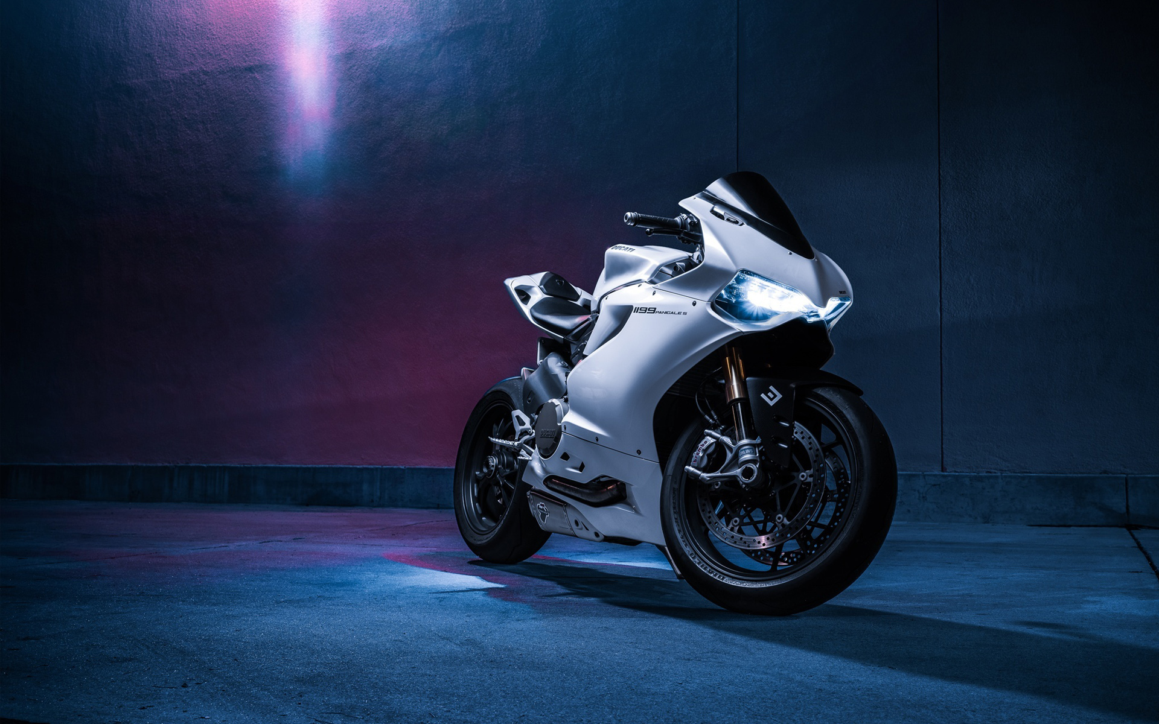
MOTOROID
HOME
RIDER
RENTER
Motorcycle
Bajaj Pulsar 150
Rencon Motors
17/2,Bir uttam sarak,North Badda,
Dhaka.
Contact: 01611111111
Home
Back

Slide 5
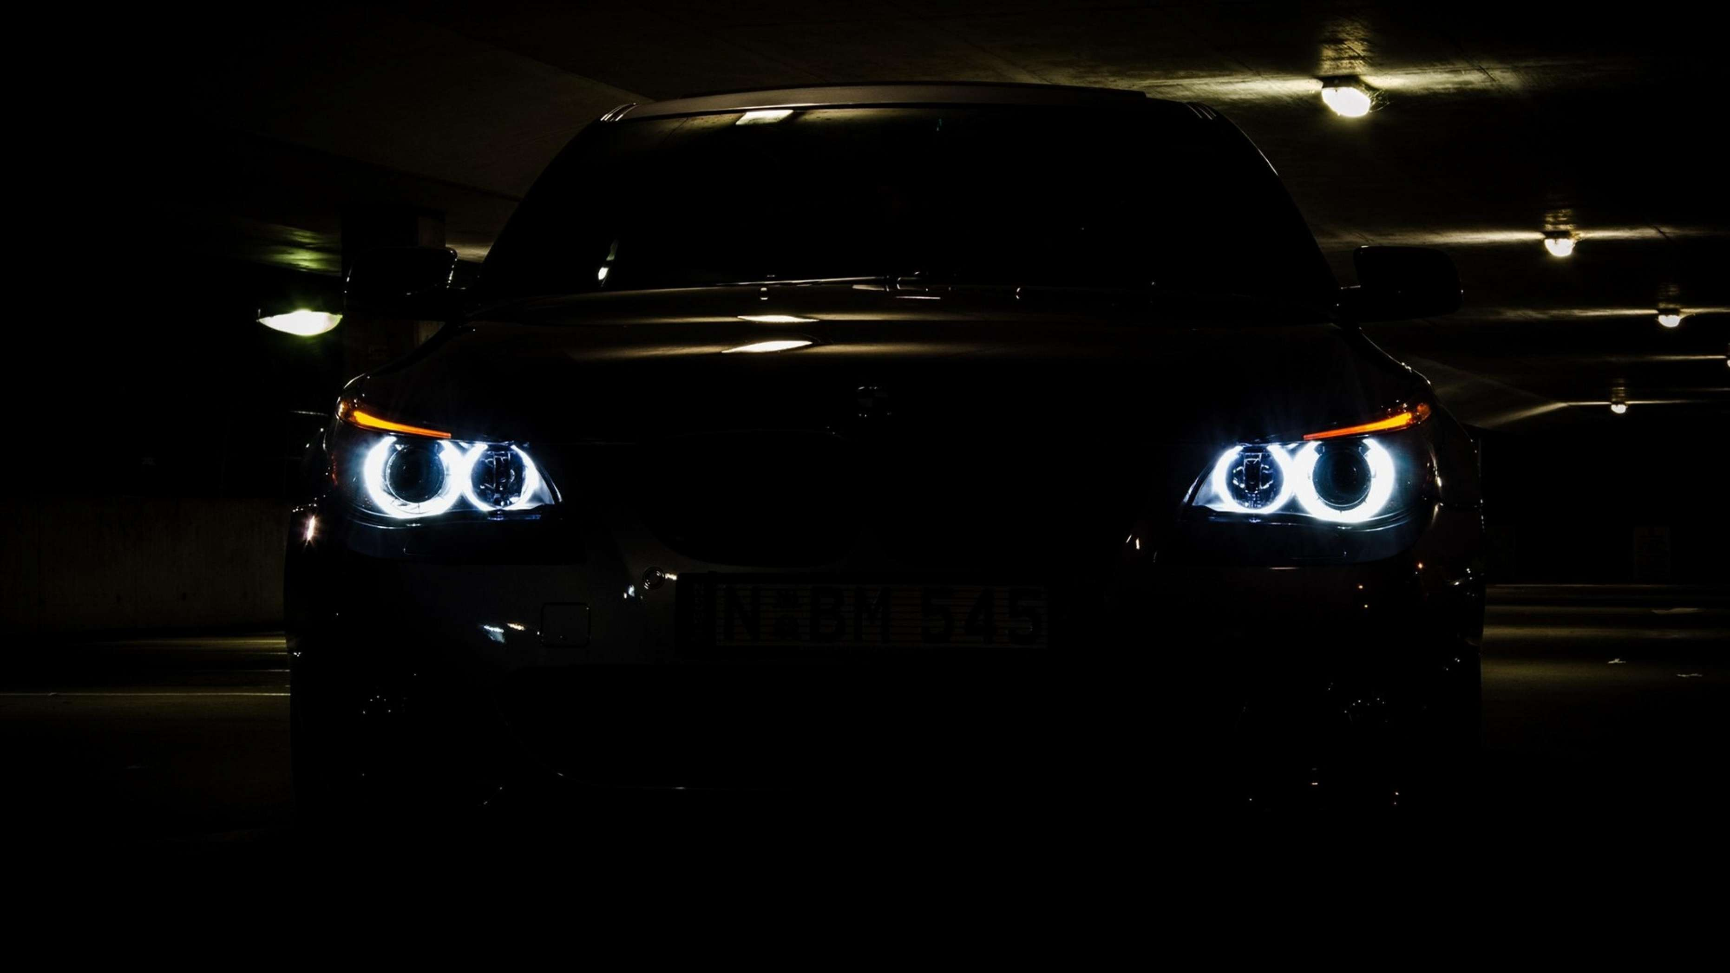
MOTOROID
HOME
RIDER
RENTER
Car
Toyota Premio G Superior
Mitshubishi Lancer EX
RENT
RENT

Slide 6
MOTOROID
HOME
RIDER
RENTER
Car
Toyota Premio G Superior
Buraq Aoutos
23/2 Sher-e bangla road
Dhanmondi,Dhaka.
Contact: 01766787878

Slide 7

MOTOROID
HOME
RIDER
RENTER
Motorcycle
Car

Slide 8
MOTOROID
HOME
RIDER
RENTER
Motorcycle
Motor Name:
Shop Name:
Adress:
Continue

